Slide 1
EY | Myself/Celebrations/Fairy Tales |  |  | People who help us/ Transport
1 | Changes within Living Memory |  | Lives of significant individuals : Mary Anning and David Attenborough |  |  | Lives of significant individuals: Tim Peake, Neil Armstrong, Mae Jemison and Bernard Harris
2 | Events Beyond Living Memory: The Great Fire of London |  | Significant historical events, people and places in their own locality: Captain Cook |  |  | REVISIT - Events Beyond Living Memory: The Great Fire of London
3 | Changes from Stone Age to the Iron Age |  | Changes from Stone Age to the Iron Age Roman Empire and its impact on Britain |  |  | Roman Empire and its impact on Britain
4 | Britain’s Settlements by Anglo-Saxons and Scots |  | Viking and Anglo-Saxon struggle for the Kingdom of England |  |  | The achievements of the earliest civilisations – Ancient Egypt
5 | Ancient Greeks |  | A non-European society that provides contrasts with British History: The Maya |  |  | Local History Study: Gertrude Bell
6 | William the Conqueror 1066 - 5 significant Monarchs |  | Chronological Study beyond 1066 Battle of Britain |  |  | Windrush Generation
scientia potentia est
Newcomen Primary School History Map

Slide 2
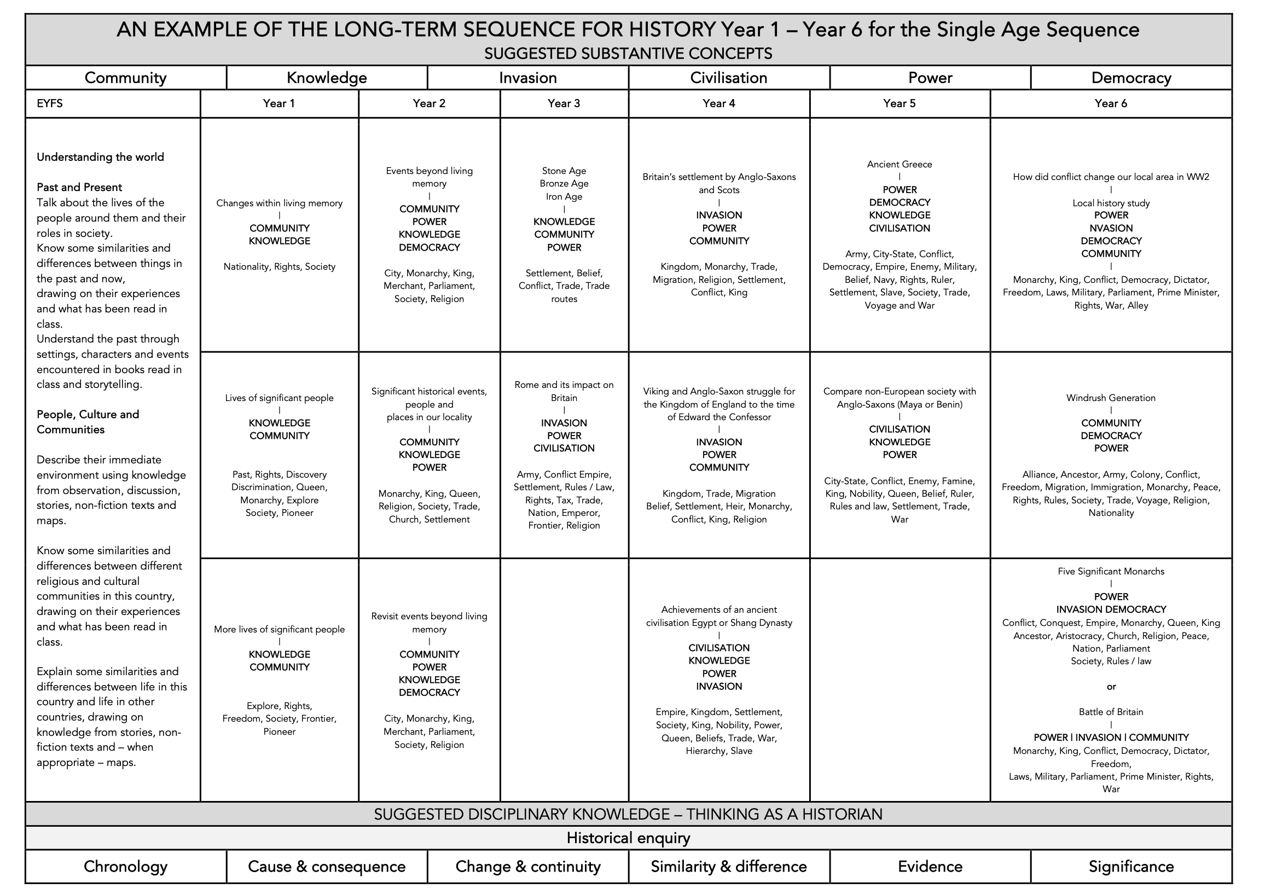
scientia potentia est
Newcomen Primary School History Concept Map

